Slide 1
A Scalable and Reliable Model for Real-time Air Quality Prediction
University of San Francisco

Slide 2

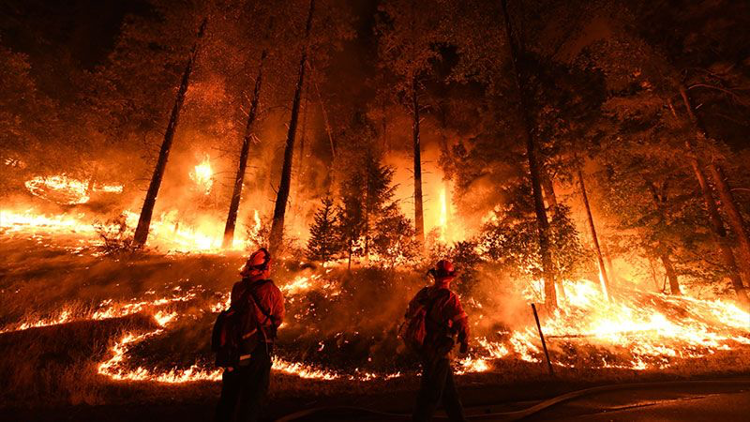
California Air Quality
California has eight of ten most polluted U.S. cities.
The air pollution issue in California is largely caused by the regular occurrences of wildfire

Slide 3
Major Outdoor Air Pollutants
Air Pollutants | Major Sources
Sulphur dioxide (SO2) | This contaminant is mainly emitted during the combustion of fossil fuels such as crude oil and coal.
Carbon monoxide (CO) | This gas consists during incomplete combustion of fuels example: A car engine running in a closed room.
Nitrogen dioxide (NO2) | These contaminants are emitted by traffic, combustion installations and the industries.
Ozone (O3) | Ozone is created through the influence of ultraviolet sunlight (UV) on pollutants in the outside air.
Particulate Matter (PM) | Particulate matter is the sum of all solid and liquid particles suspended in air. This complex mixture includes both organic and inorganic particles, such as dust, pollen, soot, smoke, and liquid droplets. These particles vary greatly in size, composition, and origin.
Notes:
Major outdoor air pollutants include ozone, particle matter, sulfur Dioxide, carbon monoxide, and nitrogen oxides
Some air pollutants can trigger adverse health problems, including respiratory disease, heart disease, lung cancer, brain damage, liver damage and kidney damage. For instance, it has been reported that fine particulate (P M 2.5) and sulfur-oxide related pollution are associated with lung cancer and cardiopulmonary mortality

Slide 4


Air Quality Prediction
Air quality forecating is an effective way of protecting pubic health
The Air Quality Index (AQI) is an index for reporting daily air quality

Slide 5
AQIs and Air Quality Levels
Air Quality Index Levels of Health Concern | Numerical Value | Meaning
Good | 0 to 50 | Air quality is considered satisfactory, and air pollution posse little or no risk.
Moderate | 51 to 100 | Air quality is acceptable; however, for some pollutants there may be a moderate health concern for a very small number of people who are unusually sensitive to air pollution.
Unhealth for Sensitive Groups | 101 to 150 | Members of sensitive groups may experience health effects. The general public is not likely to be affected.
Unhealthy | 151 to 200 | Everyone may begin to experience health effects; members groups may experience more serious health effects.
Very Unhealthy | 201 to 300 | Health alter : everyone may experience more serious health effects.
Hazardous | 301 to 500 | Health warnings of emergency conditions. The entire population is more likely to be affected.

Slide 6
Limitations of Current Air Quality Prediction Methods
Do not take account of scalable approaches for storing, managing and processing big data.
As the volume of data increases, it would be computationally expensive to train the aforementioned machine learning and deep learning models.

Slide 7



Advantages of Distributed Computing System
HIGH SPEED
RELIABLITY
COST - EFFICIENT
Notes:
Distributed computing provides high reliability by replicating data and saving copies into other machines or storing data dependencies Therefore, distributed systems enable us to process data in a fast, reliable and cost-efficient way

Slide 8
Goals
Determine
Determine the benefits of implementing pipelines on distributed systems for machine learning algorithms to achieve better computational efficiency
Evaluate
Evaluate Spark performance under various machine learning algorithms
Compare
Compare the performance of similar algorithms running on various cluster setting using Spark and a single local machine using Scikit-learn

Slide 9
Dataset Desciption
The data that we use is from the AQS Data Mart, which contains the historical air quality information across the state. The factors include air pollutants that would affect AQI, such as CO, NO₂, O₃, PM₁₀, PM_{2.5}, firm, PM_{2.5} Non-firm, PM_{2.5} speciation and SO₂. It also includes other factors like temperature, wind, and pressure.

Slide 10
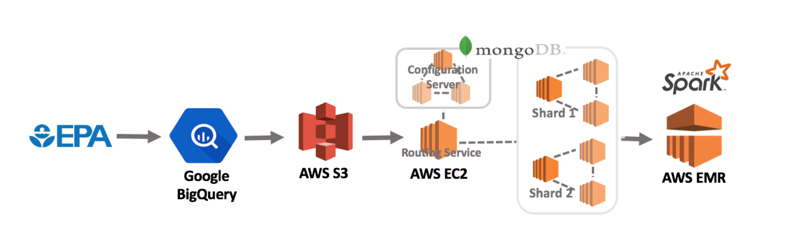
System WorkFlow

Slide 11
Cluster Setting
 | Local Machine | Cluster 1 | Cluster
Resource Manager | Standalone | YARN | YARN
Number of Nodes | 1 | 3 | 3
Number of CPU | 4 | 2 | 4
Memory (GB) | 8 | 8 | 16

Slide 12
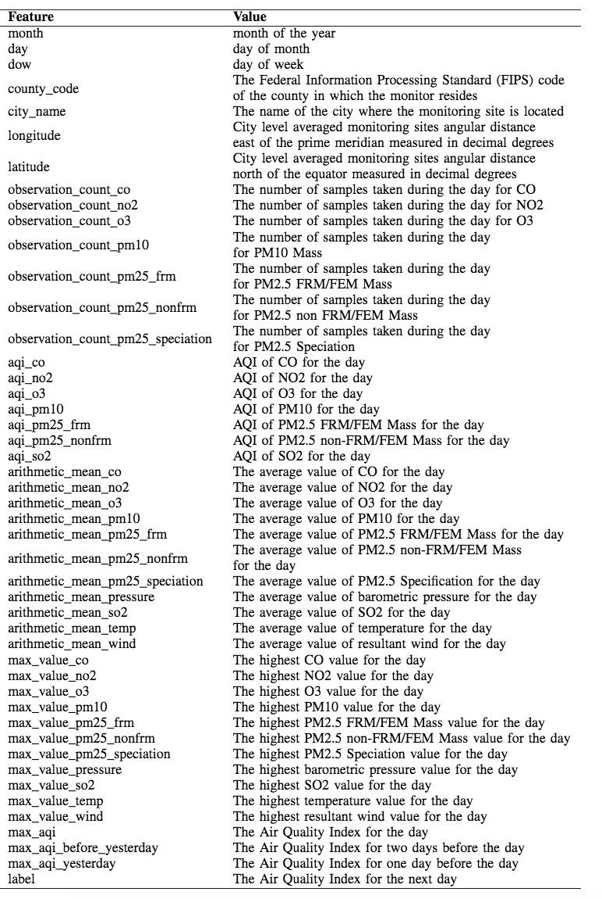
Machine Learning Models
Logistic Regression
Random Forest Classifcation
Evaluation Metrics:
Precision
Recall
F1
Accuray

Slide 13
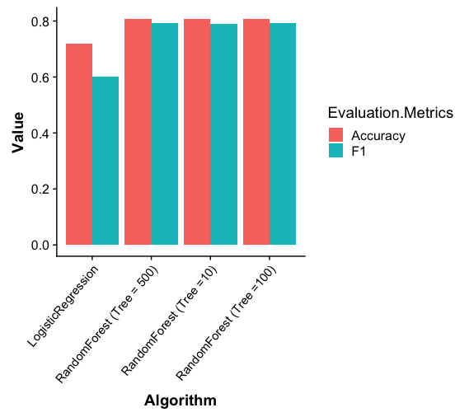
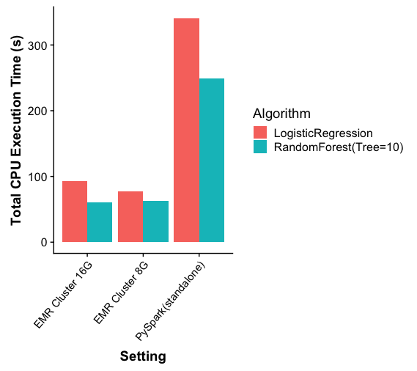
Results
Fig. 1 Model evaluation on an EMR cluster with 8GB RAM
Fig.2 Comparison of model training time

Slide 14
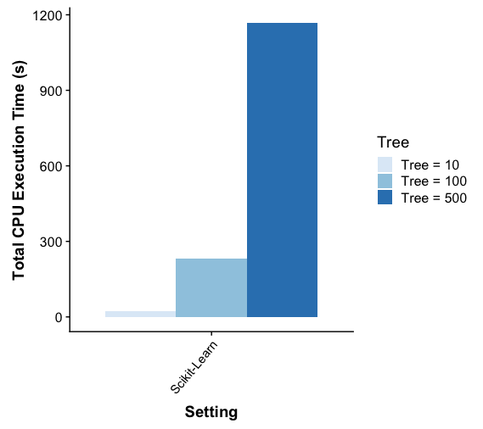
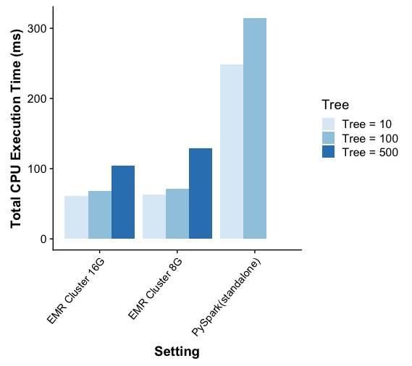
Results
Fig 3. Random Forest execution time in different settings

Slide 15
Summary
Model Performance
Random Forest showed better in accuracy and F1 score than Logistic Regression.
System Performance
A distributed setting on a cluster achieved better computational performance than a non-distributed setting.
Weighing the trade-off between the improvements in the power of data manipulation and the real cost of machines should be also taken into consideration.

